Slide 1

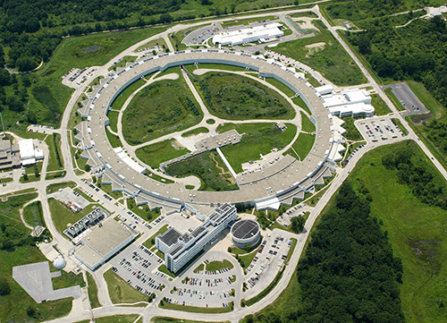
Characterize New Research Materials with AI
Adam Fouda
Eric and Wendy Schmidt AI+Science Postdoctoral Fellow
Department of Physics, University of Chicago
The Advanced Photon Source at Argonne National Laboratory generates ultra-bright X-rays to investigate materials across the biological and physical sciences

Slide 2
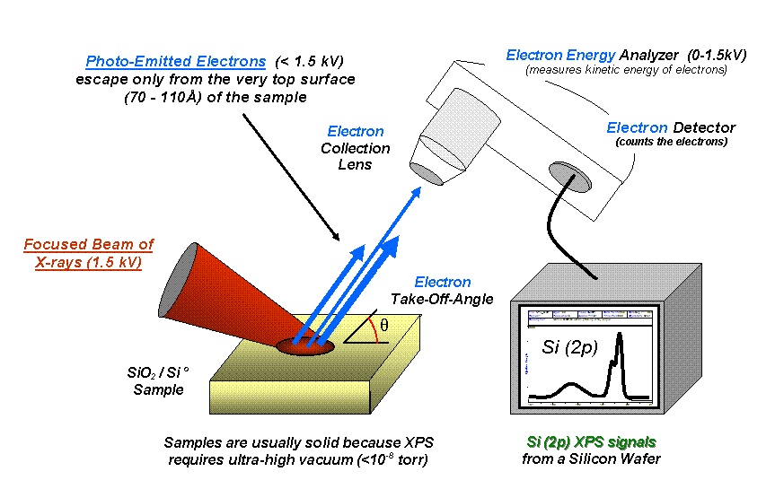
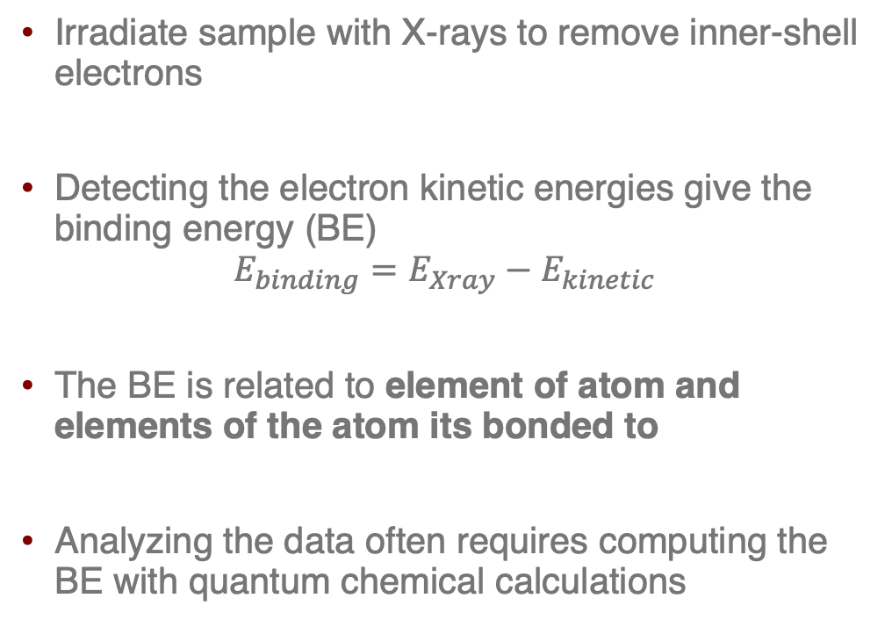
Analyzing Materials with X-rays
X-ray’s used in elementally selective analysis techniques
Electron Detector
Irradiate sample with X-rays to remove inner-shell electrons
Detecting the electron kinetic energies give the binding energy (BE)
$$E_{binding}=E_{Xray}−E_{kinetic}$$
The BE is related to element of atom and elements of the atom its bonded to
Analyzing the data often requires computing the BE with quantum chemical calculations
Emitted Photoelectrons
X-ray Beam
Material Sample
Si (2p) XPS signal
Image adapted from https://en.wikipedia.org/wiki/X-ray_photoelectron_spectroscopy

Slide 3
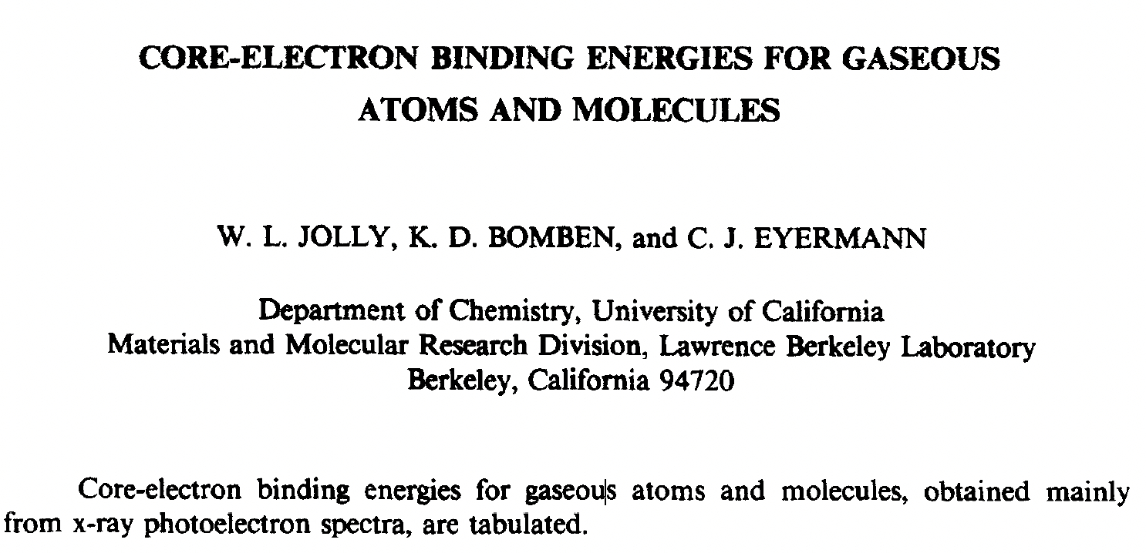
Dataset of Experimental Binding Energies
In the 1980’s researchers created a database of experimental BE’s, this was recently converted into an open-access online format
Project Goal:
Use supervised learning to predict the BE’s (node labels) from the molecular structure
Doing so can avoid the need for complex and costly quantum chemical calculations
Online version:
https://xps.ut.ee/database.html
github.com/UT-XPS/gas-phase-database

Slide 4
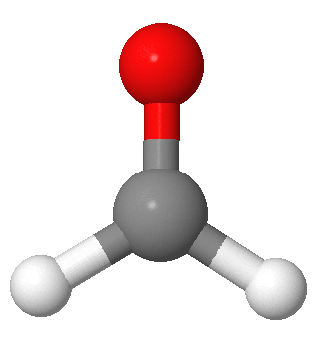
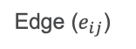
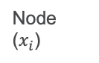
Message Passing Graph Neural Networks
Free to use any model for this challenge
We have converted the data into molecular graphs:
Nodes contain atom features
Edges contain bond features
Graph neural networks (GNN):
Atom and bond features iteratively aggregated across neighbours (convolution/message-passing)
Produce either node-level embeddings (for atomic properties) or a pooled graph-level embedding (for molecular properties)
Recommend approach: message-passing graph neural networks, for their data efficiency (only 2793 data points available)
3
Node ($x_{i}$)
1
2
4
Edge ($e_{ij}$)
Recommended Tutorial:
https://colab.research.google.com/github/chaitjo/geometric-gnn-dojo/blob/main/geometric_gnn_101.ipynb
Google colab PyTorch tutorial for molecular property prediction with message passing GNN’s
setup_material_characterize.sh sets an environment to run the code from this tutorial and will be the fastest way to start building your own GNN models from scratch!

Slide 5


Main Challenge: Use Molecular Graph Dataset to Predict the Binding Energy
Dataset Information (see training_data_info.txt):
2793 BE’s across 885 graphs (molecules: 836, atoms: 49)
There are 55 atom types
And binding energies from 17 orbital types
Sometimes 1 node will have multiple binding energies from different orbitals to predict
Tips:
Make duplicate graphs so each graph has a single orbital type and binding energy per node
Or
Multi-dimensional outputs using a one hot encoding of orbital types mapped to output vector of same length
Try both or find other ways!

Slide 6
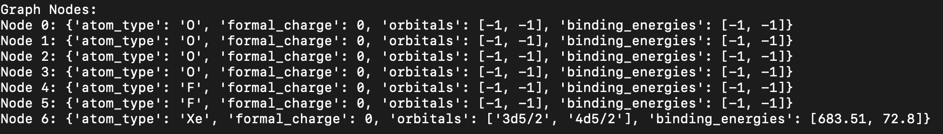
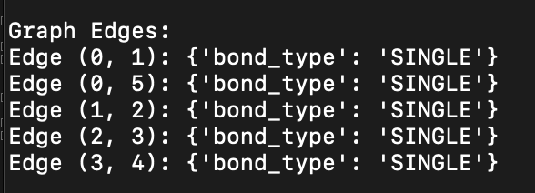
Graph Example
55 atom types, try different atom representations available in literature (one hot, SkipAtom, Mat2Vec …)
Inorganic molecules, not all atoms have bonds, fully connected graphs
Low number of features, could add more if training data size reduced, see database_2_graph.py
Detailed description of graphs provided in explain_graph_data.py
Sparse and multidimensional outputs

Slide 7
Main Challenge: Assessment
Test models against a set of 20 test molecules will be provided at the end of the challenge (test_graph_data.json)
The test data contains both high and low atom type populations
Groups will give an 8 min presentation on their findings
Credit based on two equal criteria:
Accuracy and permutation invariance of the model
Research approach, demonstrated by presenting results from different models

Slide 8
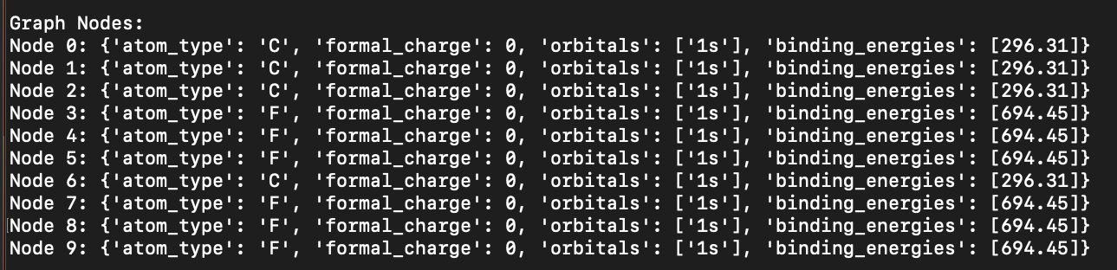
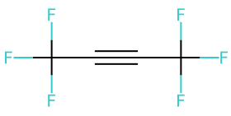
Extra Challenge:
Real data values:
CF₃C*C*CF₃: 292.73 eV
C*F₃CCC*F₃: 299.98 eV
C
C
C
C
Graphs currently contain average values for atoms of the same type in different environments.
Goal is to finding a way to more precisely extract the raw data values to the graphs
Involves navigating the inconsistencies and inaccuracies of real-world data, however doing so would enable models to have publishable accuracy.
Detailed instructions found in explain_raw_data.py

Slide 9
Any Questions?
Good luck and don’t forget to reach out to your mentor for help!
Suggested approach, split teams in two groups:
Group builds the GNN code
Group examines data and prepares graphs for the GNN
If your team decides to use the suggested tutorial, only Part 0 of the tutorial is applicable to this challenge, as molecular geometries are not included in the data

